Slide 1

COMP 4081: Software Engineering
Fall 2019
Dr. Scott Fleming, Instructor
TBA, Teaching Assistant
http://flic.kr/p/3f1RGT

Slide 2
Questions!
What are SE projects like?
What knowledge/skills must SEs master?

Slide 3
Questions!
What are SE projects like?
What knowledge/skills must SEs master?
Caveat: Every project is an individual

Slide 4


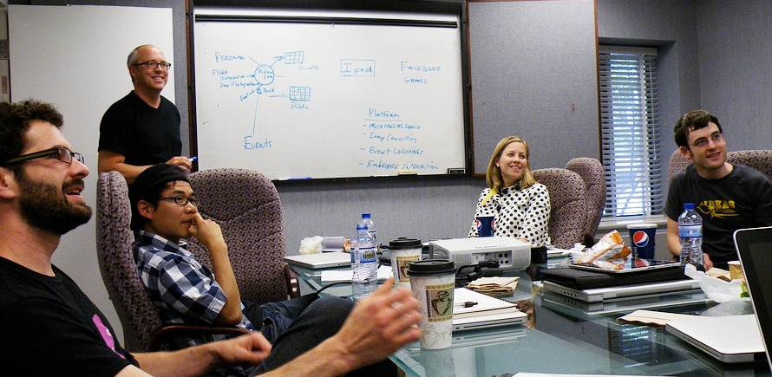
Characteristics of SE Projects
Large Scale
Customers
Teams of Developers
http://flic.kr/p/83MmEP
http://flic.kr/p/hnrKZ
http://flic.kr/p/sAPm8

Slide 5
What is the measure of a successful software engineering project?

Slide 6

What is the measure of a successful software engineering project?
Customer Satisfaction
http://flic.kr/p/hnrKZ
* OK, effect on society and humanity matters too, but humor me…

Slide 7
What do customers want?

Slide 8
What do customers want?
Software that
Meets their needs,
On time,
and
On budget

Slide 9

Unfortunately, satisfying customers is hard…
http://flic.kr/p/7pGoCd
Have you ever been a dissatisfied customer?

Slide 10
The “Software Crisis”
Since the 1960s
(More like a depression)
From the CHAOS Report 2015 by the Standish Group
Notes:
From the CHAOS Report 2015 by the Standish Group.
“All data, unless otherwise noted, represents results from FY2011-2015. The total number of software projects is 25,000-plus, with an average of 5,000 per yearly period.”

Slide 11

Even Big, High-Profile Projects Fail

Slide 12

Even Big, High-Profile Projects Fail

Slide 13
Questions!
What are SE project like?
What knowledge/skills must SEs master?

Slide 14
(pronounced “SWEE-bock”) Software Engineering Body Of Knowledge SWEBOK Guide: http://www.computer.org/web/swebok

Slide 15
15 Knowledge Areas (KAs)
Software Requirements
Software Design
Software Construction
Software Testing
Software Maintenance
Software Configuration Management
Software Engineering Management
Software Engineering Process
Software Engineering Models and Methods
Software Quality
Software Engineering Professional Practice
Software Engineering Economics
Computing Foundations
Mathematical Foundations
Engineering Foundations

Slide 16
15 Knowledge Areas (KAs)
Software Requirements
Software Design
Software Construction
Software Testing
Software Maintenance
Software Configuration Management
Software Engineering Management
Software Engineering Process
Software Engineering Models and Methods
Software Quality
Software Engineering Professional Practice
Software Engineering Economics
Computing Foundations
Mathematical Foundations
Engineering Foundations
We’ll focus on this subset

Slide 17

Summary
Traits of SE projects
Success criteria
The Software Crisis
SWEBOK
http://flic.kr/p/aCLor3

